Slide 1
EIRC of ICAI & Vitta Salahakar CA Study Circle
Bank Audit Seminar
LFAR, Advances & Documentation
CA Niranjan Joshi
01.04.2023
Kolkata
Restriction on Disclosure and Use of Data
The data in this document contains trade secrets and confidential or proprietary information of my firm, the disclosure of which would provide a competitive advantage to others. As a result, this document shall not be disclosed, used or duplicated, in whole or in part, for any purpose. The data subject to this restriction are contained in the entire document.

Slide 2
Disclaimer
These are my personal views and can not be construed to be the views of the ICAI or my firm.
No representations or warranties are made by the ICAI/RC/Branch/Study Circle with regard to this presentation.
These views do not and shall not be considered as a professional advice.
This presentation should not be reproduced in part or in whole, in any manner or form, without our written permission.
CA Niranjan Joshi

Slide 3
Agenda
Audit Planning
- Ethical Compliance
- Compliance with Standards on Auditing
- Compliance with Guidance Note
Advances
Long Form Audit Report
Documentation
CA Niranjan Joshi

Slide 4
Agenda
Ethical Compliance
Compliance with Standards on Auditing
Compliance with Guidance Note
CA Niranjan Joshi

Slide 5
Guide to the COE
Part 1 | Complying with the Code, fundamental principle and conceptual framework | Section 100 to 199
Part 2 | Professional Accountants in service | Section 200 to 299
Part 3 | Professional accountants in public practice | Section 300 to 399
Part 4 | Independence Standards | Section 400 to 999
Part 4 A | Independence for Audit and Review Engagements | Section 400 to 899
Part 4 B | Independence for assurance engagements other than audit and review | Section 900 to 999
CA Niranjan Joshi

Slide 6
Fundamental Principles
Integrity - Straightforward and honest approach, Fair dealing and truthfulness, Do not associate with communication or information containing false or misleading information, Steps to disassociate with above information once known
Objectivity - Not to compromise professional or business judgment because of bias, conflict of interest or undue influence of others. Not to undertake a professional activity if it unduly influences the accountant’s professional judgment.
Professional Competence and due care - Attain and maintain professional knowledge and skill, Act diligently and in accordance with applicable technical and professional standards, Ensure appropriate training and supervision of subordinates
CA Niranjan Joshi

Slide 7
Fundamental Principles
Confidentiality - Maintain confidentiality of information acquired as a result of professional and employment relationships, Disclose information when required by law or authorised by the client, Consider relevant factors while deciding disclosure of confidential information, Maintain confidentiality even after the end of relationship with client
Professional Behaviour - Avoid activities that impair the reputation of the profession, Do not make exaggerated claims for services offered, and disparaging references or unsubstantiated comparisons with others, Do not advertise any professional/other facts which are in violation of Advertisement Guidelines of ICAI
Threats to avoid
Self Interest Threat, Self Review Threat, Advocacy Threat,
Familiarity Threat, Intimidation Threat.
CA Niranjan Joshi

Slide 8
Agenda
Ethical Compliance
Compliance with Standards on Auditing
Compliance with Guidance Note
CA Niranjan Joshi

Slide 9
Standards on Auditing
SQC1 – Quality Control for Firms
SA 200 – Basic Principles Governing Audit.
SA 230 – Audit Documentation
SA 500 – Audit Evidence
SA 400 – Risk Assessment and Internal Control
SA 300 – Audit Planning
SA 220 – Quality Control for Audit Work
SA 299 – Joint Audit of Financial Statements
SA 310 – Knowledge of Business
SA 600 – Using work of another auditor
CA Niranjan Joshi

Slide 10
Audit Execution
SA 320 – Audit Materiality
SA 520 – Analytical Procedures
SA 530 – Audit Sampling
SA 220 – Quality Control For Audit Work
Analyze and Evaluate the errors in samples selected
Get the rectification / MOC Passed
Work as per Audit Program and schedule
Prepare reports according to requirement
Qualify in Audit Report if necessary
Knowledge about CAAT tools
CA Niranjan Joshi

Slide 11
Audit Planning & Checklist
Applicable Act for the Bank
Appointment Letter / Acceptance Letter
Closing Manual of Bank
NOC of Previous Auditor.
Audit Engagement Letter.
Basic Information from branch.
Audit Program / Checklist
Study RBI Circulars
Attend Trainings / Workshops / Seminars
Have knowledge of current affairs
CA Niranjan Joshi

Slide 12
Audit Planning & Checklist
Have knowledge of the:
Economy
Banking Industry
Government Policies
Rules & Regulations applicable to the Bank
Products handled by Bank
Complexities involved
Applicability of Accounting Standards
Applicability Auditing and Assurance Standards.
FEDAI Guidelines
CA Niranjan Joshi

Slide 13
Audit Program
Define broadly the scope of audit.
Include Certificates in main audit plan.
Identify the thrust areas.
Set materiality levels standards for each area.
Lay down over all time schedule.
Training to Audit staff and special skill if required.
Weak areas identified during the Audit – extra focus.
Physical verification of cash and other securities / Sensitive Accounts
Frauds / Sundry Assets / Suspense Account / Inter Branch reconciliation
Contingent Liabilities
Contingent Liabilities not acknowledged
CA Niranjan Joshi

Slide 14
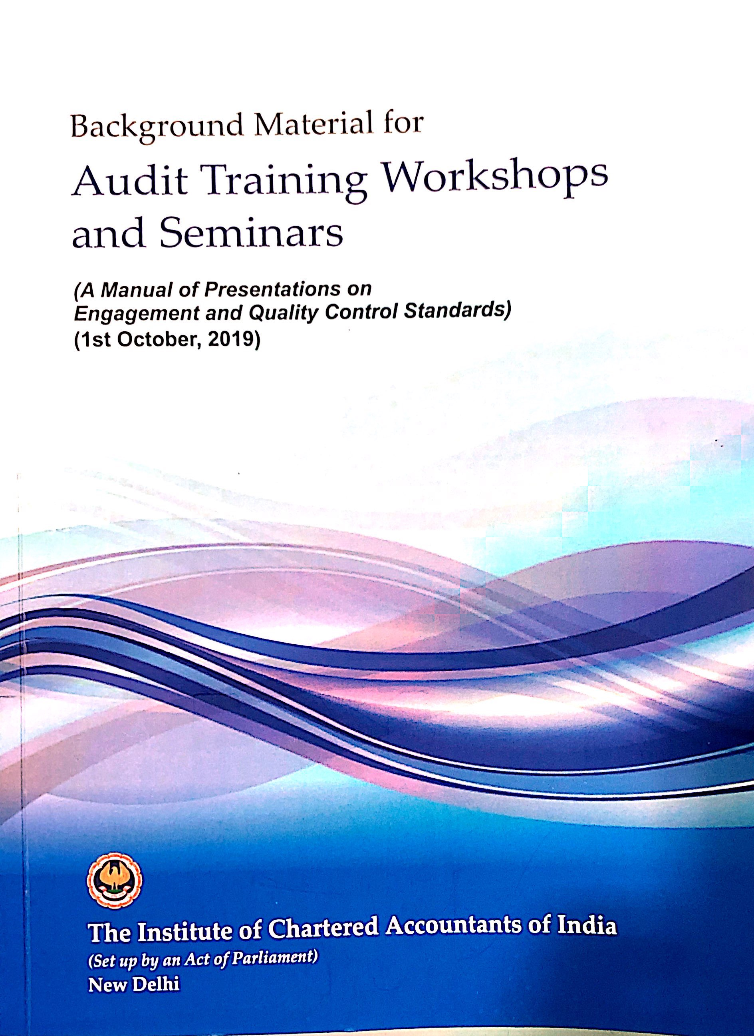
Background Material for SA’s
CA Niranjan Joshi

Slide 15
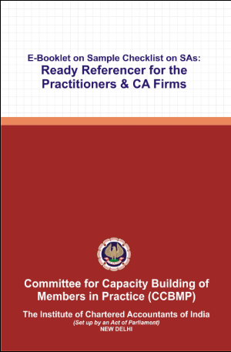
Sample Checklists
CA Niranjan Joshi

Slide 16
Agenda
Ethical Compliance
Compliance with Standards on Auditing
Compliance with Guidance Note
CA Niranjan Joshi

Slide 17
Objective
Compliance with:
- RBI / ICAI Guidelines
- Terms of Appointment
- Accounting Standards
- Standards on Auditing
Other Certification work
Effective Reporting
Completion of Work in Time
CA Niranjan Joshi

Slide 18
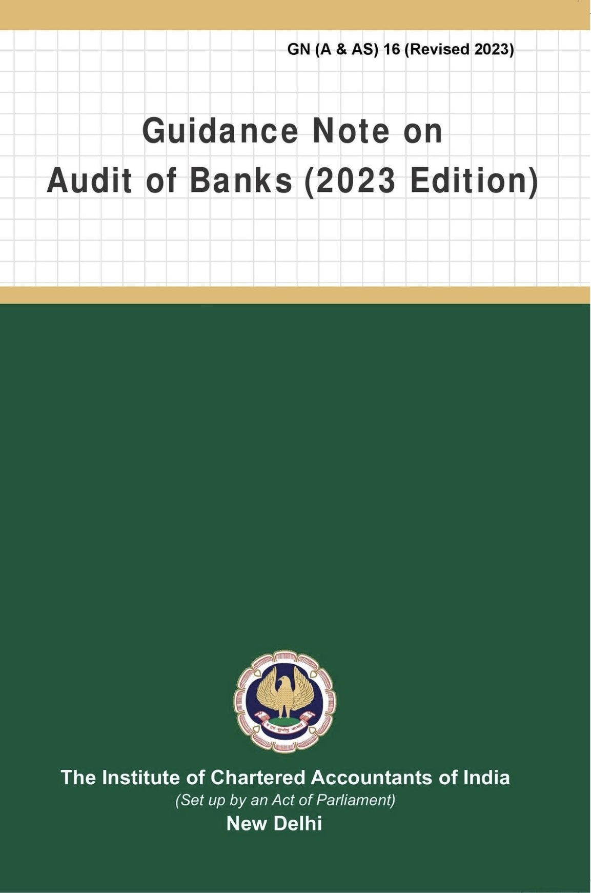
Branch Audit
Read and Follow

Slide 19
Ground Work at Office
Preliminary Work
Evaluation of Internal Controls
Prepare Audit Program
Overall Time & Manpower Planning
Laying Overall Audit Plan
CA Niranjan Joshi

Slide 20
Audit Process
Audit Program
Audit Execution
Effective Reporting
Working Papers
CA Niranjan Joshi

Slide 21
Audit Trail
Manual Registers / Records
Core Banking Solution CBS
Management Information System
Data made available for remote audit
Lack of Adequate Information
Lack of Adequate Knowledge of system
Lack of audit Trail
CA Niranjan Joshi

Slide 22
RBI Circulars
Read and Check compliance for RBI Circulars hosted on website / available with bank branch
Index to RBI Circulars
https://www.rbi.org.in/Scripts/BS_CircularIndexDisplay.aspx
CA Niranjan Joshi

Slide 23
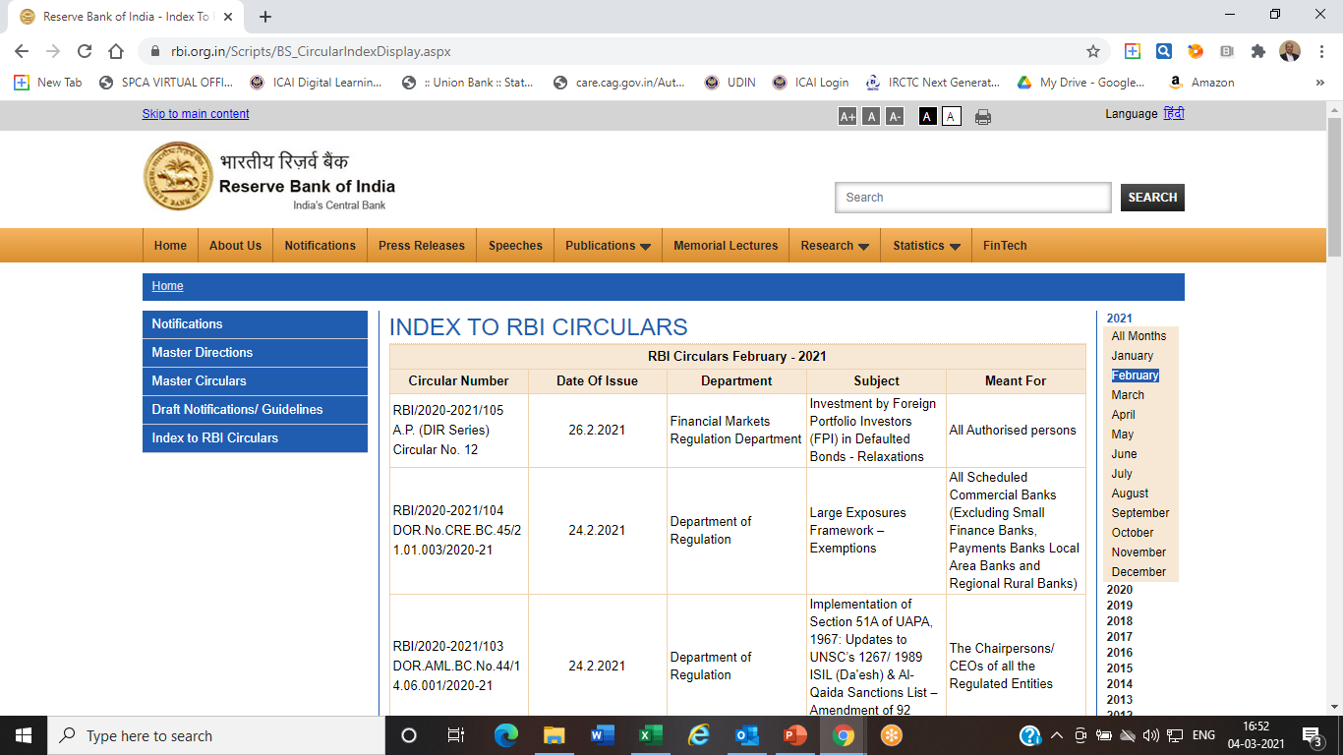
CA Niranjan Joshi

Slide 24
Agenda
Audit Planning
- Ethical Compliance
- Compliance with Standards on Auditing
- Compliance with Guidance Note
Advances
Long Form Audit Report
Documentation
CA Niranjan Joshi

Slide 25
Types of Advances
Fund Based – Outflow of Funds immediate
Cash Credit – Clean, Hypothecation
Overdrafts – Secured/Unsecured
Term Loans – Fixed Period / Asset Created
WCTL – Fixed Period/Renewable
Bills – Purchase/Discounted or Collection
Exports Credit – Pre/Post Shipment
Imports Credit – Capital Goods/RM
Non Fund Based – Outflow of Funds not immediate
Letter of Credit (LC)/ Letter of Guarantee (LG/BG)/ Letter of Comfort (LoC)/ Buyers Credit (BC)/ Standby Letter of Credit (SBLC)/ Deferred Payment Guarantee (DPG)
CA Niranjan Joshi

Slide 26
Types of Advances
Security wise Classification
Secured (Prime / Collateral) (Tangible / Intangible) (Hypothecation, Pledge, Mortgage, Assignment)
Unsecured
Sector wise Classification
Priority Sector Advances – (Agriculture, Education, Housing, Export Credit, MSME, Social Infra, Renewable Energy)
Other (Non Priority Sector) Advances
CA Niranjan Joshi

Slide 27
Verification of Advances
Set up materiality
Selection of Sample
Testing of Sample Selected
Noting down the observations
Discussion with the branch Management
Reporting appropriately
CA Niranjan Joshi

Slide 28
Sample Selection - Advances
Cash Credit | 25% – 40% Sanction 25% – 40% Renewals
Overdraft | 5% – 1 0% Against Security 75% – 100% Clean
Term Loans | 20% – 30% Sanction
Import / Export | 15% – 25% of Sanction
BG | 15% – 20% of Sanction
LC | 15% – 20% of Sanction
Loc/BC | 50% – 75% of Sanction
10% of Total Advances of Branch OR Rs. 10 Crores whichever is lower – 100%
Schematic / Retail Loans at least 5% – 10% of each type (Housing/Vehicle/Personal/Against Deposit/Gold/Education/etc.)

Slide 29
Audit Area
Pre Sanction
Post Sanction
Loan Application
Credit Appraisal
Documentation
External Reports
Disbursement
Review
Monitoring
Supervision
CA Niranjan Joshi

Slide 30
Loan Application/ Credit Appraisal
Application Form
KYC Compliance
Project Reports / Feasibility Report
Latest audited financial statements
Statutory Registrations
NOCs from Government Departments
Adequate security cover
Sanctions within the discretionary DOP
Change in the terms of sanction is ratified by appropriate authority.
Short Review / Technical Review
Adhoc Limits / Temporary limits
CA Niranjan Joshi

Slide 31
Adhoc/Short Review – 21.08.2020
Banks are expected to have a detailed Board approved policy on methodology and periodicity for review/renewal of credit facilities within the overall regulatory guidelines, and adhere to the same strictly.
However, an analysis of practices followed by the lenders while reviewing/renewing credit facilities has brought out certain supervisory concerns, including that of frequent/repeated ad-hoc review/renewal of credit facilities instead of regular review/renewals, non-capturing and/or inaccurate capturing of review/renewal data in the banking/information systems, and non-coverage of review/renewal activities under the concurrent audit/internal audit mechanism.
CA Niranjan Joshi

Slide 32
Adhoc/Short Review – 21.08.2020
In this connection, we reiterate that timely and comprehensive review/renewal of credit facilities should be an integral part of the Board approved loan policy and credit risk management framework, and banks should avoid frequent and repeated ad-hoc/short review/renewal of credit facilities without justifiable reasons.
Banks are also advised to capture all the data relating to regular as well as ad-hoc/short review/renewal of credit facilities in their core banking systems/management information systems and make the same available for scrutiny as and when required by any audit or inspection by Auditors/RBI. Further, the processes governing review/renewal of credit facilities should be brought under the scope of concurrent/internal audit/internal control mechanism of banks with immediate effect.
CA Niranjan Joshi

Slide 33
Documentation
Sanction T & C to be accepted by the borrower.
Execution of Loan documents, as per the sanction letter & loan policy.
Fresh loan documents are obtained on change in limit, change in constitution of the borrower
Original documents are held in safe custody
Charge at Appropriate Authorities Registered
Updation of Information in CBS Master
Compliance with Stamp Duty
Adequate Insurance of Securities and Bank’s Clause.
CA Niranjan Joshi

Slide 34
External Reports / Documents
Confidential report & NOC from existing banker.
CIBIL Report – Adverse comments / Score
Valuation of Securities.
Credit Rating – Internal / External
Due Diligence Certificate [Multiple/ Consortium]
Vetting of Legal Documents by Legal Expert.
CA Niranjan Joshi

Slide 35
Disbursement
Client Master in CBS Properly recorded.
Verify that Disbursement done only after compliance of all terms & conditions of Sanction.
Acceptance of the borrower confirming the terms & conditions of sanction is obtained.
Home Loans/ term loans to be disbursed directly to the Builder / Owner/ supplier.
Post Disbursement Inspection
Monitoring of End Use of Funds
CA Niranjan Joshi

Slide 36
Review / Monitoring / Supervision
TOL / TODs
Stock Statements / Drawing Power
Insurance Policy
Submission of Audited FS
Credit Audit / Stock Audit etc
Visit Reports
Account Statements / Operations
Review / Renewal of Proposals
Early Warning Signals (EWS)
CA Niranjan Joshi

Slide 37
Agenda
Audit Planning
- Ethical Compliance
- Compliance with Standards on Auditing
- Compliance with Guidance Note
Advances
Long Form Audit Report
Documentation
CA Niranjan Joshi

Slide 38
Reporting
Statutory Audit Report – Addressed to SCA/Bank
SA 700 – Forming an opinion & Reporting on Financial Statements
SA 701 – Communicating Key Audit Matters
SA 705 – Modifications to the opinion in the independent auditors report
SA 706 – Emphasis of Matter Paragraph or Other Matter Paragraph
SA 720 – Auditors Responsibility relating to Other Information
KAM / Modified Opinion / EOM / OM – all are different.
CA Niranjan Joshi

Slide 39
Reporting
Statutory Audit Report
Compliance with Accounting Standards to be mentioned in main report.
Qualifications can be through Memorandum of Changes or Specific remarks in the last para.
Illustrative Format Bank Audit Guidance Note 2020
Add annexures / supporting documents to the report wherever necessary
CA Niranjan Joshi

Slide 40
Memorandum of Changes – MOC
Memorandum of Changes (summary)
 | No. | Increase | Decrease
In respect of Income
In respect of expenditure
In respect of Assets
In respect of Liabilities
In respect of Gross NPAs
In respect of Provision on NPAs
In respect of Classification of Advances
In respect of Risk Weighted Assets
Other items (if any)
CA Niranjan Joshi

Slide 41
Long Form Audit Report
Internal control evaluation questionnaire
Comprehensive in scope and coverage
Covers Balance Sheet & Profit & Loss A/c
Important check list for Audit Plan
CA Niranjan Joshi

Slide 42
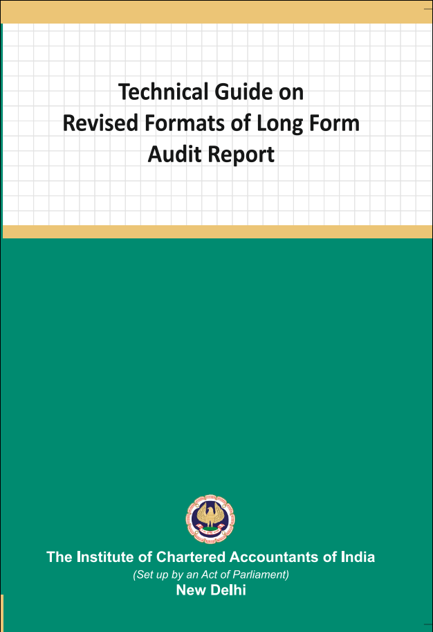
Technical Guide on Revised LFAR 2021
CA Niranjan Joshi

Slide 43
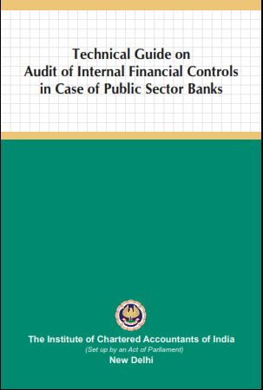
Technical Guide on IFCoFR 2021
CA Niranjan Joshi

Slide 44
LFAR Audit Approach
Read All questions in LFAR
Plan & Design Audit Program to cover all aspects of LFAR
Prepare separate checklists for each point to be reported.
Record the extent of checking / sample selected.
Proper documentation & collecting SAAE during the audit.
Write descriptive answers. Avoid Y/N/NA
Include facts, figures and examples to the extent possible in all answers to the questions.
CA Niranjan Joshi

Slide 45
LFAR Audit Approach
Observations resulting in adjustments to account heads needs to be reported along with MOC
Discuss the contents of report with Branch Management
Obtain Management Representation from Branch Manager on various matters based on Audit.
LFAR is an independent report, hence do not give cross reference or qualifications or MOC in LFAR.
It’s a very important report for readers such as SCA and Management of Bank.
CA Niranjan Joshi

Slide 46
You can please some of the people some of the time…
But you can’t please all of the people all of the time.
CA Niranjan Joshi

Slide 47
Revised LFAR – 05.09.2020
Long Form Audit Report for FY 2020 – 21
The format of LFAR, as mentioned below, have been revised:
Annex I for Statutory Central Auditors (SCA)
Annex II for Branch Auditors
An Appendix as part of Annex II for the specialized branches and
Annex III on Large / Irregular / Critical accounts for branch auditors.
CA Niranjan Joshi

Slide 48
Revised LFAR – 05.09.2020
The overall objective of the branch audit should be to have transaction testing and provide inputs to the SCAs on adequacy of implementation of various policy and regulatory requirements, including efficacy of the system and assurance functions (risk management, compliance and internal audit) at branch level.
The threshold fixed for different purposes for comments in the LFAR will decide that above the threshold, the transaction detailing needs to be seen and commented upon. However, below the threshold, the system and processes should be checked and commented upon.
Verification of data integrity and data related control systems and processes should be carried out and commented upon, with the special thrust on those data inputs which are to be used for MIS at corporate office level and for supervisory reporting purposes.
CA Niranjan Joshi

Slide 49
Revised LFAR – 05.09.2020
Where any of the comments made by the auditors in their LFAR is adverse, they should consider whether a qualification in their main report is necessary. It should not, however, be assumed that every adverse comment in the LFAR would necessarily result in a qualification in the main report. In deciding whether a qualification in the main report is necessary, the auditors should use their professional judgment in the facts and circumstances of each case.
CA Niranjan Joshi

Slide 50
Overview of LFAR - Assets
Particulars | Check Points
1. Cash (4 / 5)
cash maintained is in effective joint custody of two or more officials, | Review effectiveness of joint custody of Cash Vault / ATM
Have the cash balances at the branch/ATMs been checked at periodic intervals | Check policy of bank Verify from cash register Report inconsistencies
cash balances, which vary significantly from the limits fixed | Cash Retention Limit for branch Verify the status of cash retained by branch during the year and comment. Verify instances of excess cash are being reported to the CO/HO.
CA Niranjan Joshi

Slide 51
Overview of LFAR - Assets
Particulars | Check Points
1. Cash (4 / 5)
cash with its ATM(s) tally with the amounts of balances with the respective ATMs, based on the year end scrolls generated by the ATMs? | Verify with the ATM Balance Reports and comment
Whether the insurance cover available with the branch adequately meets the requirement to cover the cash-in hand and cash-in transit? | Verify the Insurance Policy and Comment
CA Niranjan Joshi

Slide 52
Overview of LFAR - Assets
Particulars | Check Points
2. Balance with RBI, SBI and Other Banks (For branches with Treasury Operations) (3/3)
Balance Confirmation | Obtain balance confirmations
Review of Reconciliation Statement | Review reconciliation process and its consistency through out the year
Any special Observations | Review the reconciliation items compelling MoCs and special attention items
CA Niranjan Joshi

Slide 53
Overview of LFAR - Assets
Particulars | Check Points
3. Money at Call and at short Notice (1/4)
Whether “branch” has kept anytime during the year | Generally not observed in PSU Bank’s Branches (applicable to Treasury Department)
Has the year-end balance been duly confirmed and reconciled?
Has interest accrued up to the year-end been properly recorded?
Whether instructions/ guidelines, if any, laid down by the controlling authorities of the bank have been complied with?
CA Niranjan Joshi

Slide 54
Overview of LFAR - Assets
Particulars | Check Points
4. Investments – Branches in India (4/0)
4. Investments – Branches outside India (4/4)
has the branch acted within its delegated authority | Generally SBAs are appointed locally for Branches outside India.
physical verification of the investments held by the branch
valuation of investments in accordance with the RBI /regulatory authority of the country in which the branch is located whichever are more stringent?
any matured or overdue investments
CA Niranjan Joshi

Slide 55
Overview of LFAR - Assets
General Instructions for Advances
The answers to the following questions may be based on the auditor’s examination of all large advances.
For this purpose, large advances are those in respect of which the outstanding amount is in excess of 10% of outstanding aggregate balance of fund based and non-fund based advances of the branch or Rs.10 crores, whichever is less.
Care- For all accounts above the threshold, the transaction audit/account specific details to be seen and commented, whereas below the threshold, the process needs to be checked and commented upon. Comments of the branch auditor on advances with significant adverse features, which might need the attention of the management / Statutory Central Auditors, should be appended to the LFAR.
CA Niranjan Joshi

Slide 56
Overview of LFAR - Assets
The critical comments based on the review of the above and other test check should be given in respective paragraphs as given in LFAR given below.
List of Advances Accounts examined for Audit
Account Number,
Account Name,
Balance as at Year end (Funded),
Balance as at Year end (Non Funded),
Total.
Specify % of examined by SBAs
CA Niranjan Joshi

Slide 57
Overview of LFAR - Assets
Particulars | Check Points
5. Advances
Credit Appraisal
Have you come across cases of quick mortality in accounts, where the facility became non-performing within a period of 12 months from the date of first sanction? Details of such accounts may be provided in following manner:- • Account No. • Account Name • Balance as at year end | Verify the list of such cases from correspondence / MIS reporting Comment appropriately Include in MRL, if there are no quick mortality cases at branch
CA Niranjan Joshi

Slide 58
Overview of LFAR - Assets
Particulars | Check Points
5. Advances
Credit Appraisal
Compliance with the procedures/ instructions of the HO/CO regarding loan applications, preparation of proposals for grant/ renewal of advances, enhancement of limits, etc., including adequate appraisal documentation in respect thereof. What, in your opinion, are the major shortcomings in credit appraisal, etc. | Read Loan / Credit Policy Verify the sample selected as per requirements of HO Guidelines Comment about deficiencies observed as per the points mentioned in question
CA Niranjan Joshi

Slide 59
Overview of LFAR - Assets
Particulars | Check Points
5. Advances
Credit Appraisal
applicable interest rate is correctly fed into the system? | Verify Account Master on test check and comment. Also ROI related reports generated by CBS
interest rate is reviewed MCLR / EBLR (External Benchmark Lending Rate)? | Refer to HO Circular and comment appropriately
Have you come across cases of frequent renewal / rollover of short-term loans? | Verify the accounts renewed / rolled over and comment
Correct and valid credit rating | Verify the requirements of Internal / External Credit Rating and comment
CA Niranjan Joshi

Slide 60
Overview of LFAR - Assets
Particulars | Check Points
5. Advances
Sanctioning and disbursement (3/4)
Facilities sanctioned beyond delegated authority and reported to CO | Refer Credit Policy and authority matrix (DOP) and comment
Disbursement without complying with terms and conditions | Refer terms and conditions and moratorium period given if any for compliance
Acceptance and compliance with Sanction letter & Disbursement without executing loan documents | Signatures of the borrower / co-borrower and guarantor required Partially filled up / documents executed blank / LAD / SC/BC
loans to companies for buy-back of shares/securities? | Enquire with management, check the sample selected and verify end use of funds by borrower and comment
CA Niranjan Joshi

Slide 61
Overview of LFAR - Assets
Particulars | Check Points
5. Advances
Documentation (3/3)
Without execution of necessary documentation | Verify loan documents for sample selected and comment
Deficiencies - non-registration of charges, non-obtaining of guarantees, etc. | SERSAI / ROC-MCA Charge/Society Charge for housing loan / Charge on land in case of Agri Loans etc
Loan against deposits granted without marking a lien | Lien marking physically and in system System of renewal of such FDRs
CA Niranjan Joshi

Slide 62
Overview of LFAR - Assets
Particulars | Check Points
5. Advances
Review / Monitoring / Supervision (10/10)
Periodic Review / Balance Confirmation / Letter of Acknowledgement of Debts | Blank undated LAD / BC / SC LAD to be obtained as per HO Policy
Scrutiny of Stock & Book Debts Statements / Other Financial Statements | Review system of calculation of Drawing Power vis-à-vis financials Maintain test data records
Stock Audit Reports / Compliance | Review stock audit reports on sample basis with special thrust on adverse comments
Deficiencies - in value of securities & inspection thereof, frequent overdrawing beyond limits, inadequate insurance coverage, etc.? | For sample selected, verify and comment about current and previous valuation of security / inspection etc. and comment. Also verify the value mentioned in Insurance Policy with valuation report
CA Niranjan Joshi

Slide 63
Overview of LFAR - Assets
Particulars | Check Points
5. Advances
Review / Monitoring / Supervision
Whether the branch has any red-flagged account? any deviations were observed related to compliance | List to be obtained from branch / MIS Verify and comment about red-flagged accounts
adverse features considered significant in top 5 standard large advances and which need management's attention. | List of top 5 standard account (exposure / outstanding as on 31.03.2021) Verify annexure to LFAR and comment about adverse features, if any
leasing finance activities, Compliance | Obtain list, verify the sample and comment
Advance to non- corporate entities (limits fixed by banks) branch has not obtained the duly audited accounts | Obtain HO circular for limit of 10/25 Lakh Verify whether Audited Financial Statement obtianed for 31.03.2020 and comment
CA Niranjan Joshi

Slide 64
Overview of LFAR - Assets
Particulars | Check Points
5. Advances
Review / Monitoring / Supervision
due diligence report of advances under consortium and multiple banking arrangements. Give the list of accounts non compliance. | Obtain list of Consortium/ MB account Verify the due diligence report of sample selected and comment Report cases where such report is not available
Inspection or physical verification of securities charged to the bank. Is there a substantial deterioration in value of security during financial year as per latest valuation report in comparison with earlier valuation report on record? | Obtain policy of bank in this regard Verify register maintained for visits Verify visit report submitted by officers Check and comment based on sample selected
CA Niranjan Joshi

Slide 65
Overview of LFAR - Assets
Particulars | Check Points
5. Advances
Asset Classification, Provisioning of Advances and Resolution of Stressed Assets (0/12)
i) a) Has the branch identified and classified advances into standard / substandard / doubtful / loss assets through the computer system, without manual intervention? | Verify the software used and comment whether manual intervention is observed or not.
b) Is this identification & classification in line with the norms prescribed by the Reserve Bank of India | System of (auto-marking) auto-identification and marking of NPAs Classification and reporting of Advances Lodgment of claims for DICGC / ECGC (in chart format), etc.
CA Niranjan Joshi

Slide 66
Overview of LFAR - Assets
Particulars | Check Points
5. Advances
Asset Classification, Provisioning of Advances and Resolution of Stressed Assets (0/12)
c) Whether the branch is following the system of classifying the account into SMA-0, SMA-1, and SMA-2. Whether the auditor disagrees with the branch classification of advances into standard (Including SMA-0, SMA- 1, SMA-2) / SS / DB / Loss. | Verify the MIS/CBS Reports Check sample for verification of SMA category Report inconsistencies Verify NPA Statement and comment
d) Also indicate whether required changes have been incorporated/ suggested in the Memorandum of Changes. | If MOC suggested, report appropriately here
CA Niranjan Joshi

Slide 67
Overview of LFAR - Assets
Particulars | Check Points
5. Advances
Asset Classification, Provisioning of Advances and Resolution of Stressed Assets (0/12)
e) List the accounts (with outstanding in excess of Rs. 10.00 crore) which have either been downgraded or upgraded with regard to their classification as Non-Performing Asset or Standard Asset during the year and the reason thereof. | Select these accounts in Sample for verification. Check upgrades are as per the criteria mentioned in Prudential Guidelines on IRAC Check downgrades are as per ageing process from Std to SS/DB1/DB2/DB3/Loss Report appropriately.
f) Whether RBI guidelines on income recognition and provisioning have been followed. | Verify the sample selected and report appropriately.
CA Niranjan Joshi

Slide 68
Overview of LFAR - Assets
Particulars | Check Points
5. Advances
Asset Classification, Provisioning of Advances and Resolution of Stressed Assets (0/12)
ii) a)Whether the branch has reported accounts restructured/ rephased during the year to CO of the bank? | Verify the Santion Letter Report compliance with T & C
b)Whether the RBI Guidelines for restructuring on all such cases have been followed. | Refer to various RBI Circulars on restructuring and verify the accounts restructured.
c)Whether the branch complies with the regulatory stance for resolution of stressed assets, including the compliance with board approved policies in this regard, tracking/reporting of defaults for resolution purposes among others? | Verify sample selected and comment
CA Niranjan Joshi

Slide 69
Overview of LFAR - Assets
Particulars | Check Points
5. Advances
Asset Classification, Provisioning of Advances and Resolution of Stressed Assets (0/12)
iii) a) Whether the upgradations in non-performing advances is in line with the norms of Reserve Bank of India | Select sample of accounts upgraded and report appropriately
b) Where the auditor disagrees with upgradation of accounts? If yes, give reasons thereof. | Select sample of accounts upgraded and report appropriately
CA Niranjan Joshi

Slide 70
Overview of LFAR - Assets
Particulars | Check Points
5. Advances
Asset Classification, Provisioning of Advances and Resolution of Stressed Assets (0/12)
iv. Have you come across cases where the relevant Controlling Authority of the bank has authorized legal action for recovery of advances or recalling of advances, but no such action was taken by the branch? | Verify sample selected and comment
v. Whether there are any accounts wherein process under IBC is mandated but not initiated by the branch? Whether there are any borrowers at the branch against whom the process of IBC is initiated by any of the creditors including bank? If yes, provide the list of such accounts and comment on the adequacy of provision made thereto? | Obtain list of eligible case for IBC Check approvals of competent authority to proceed for IBC and comment
CA Niranjan Joshi

Slide 71
Overview of LFAR - Assets
Particulars | Check Points
5. Advances
Asset Classification, Provisioning of Advances and Resolution of Stressed Assets (0/12)
vi) a) Have appropriate claims for credit guarantee (ECGC and others), if any, been duly lodged and settled? (Details to be given in format prescribed) | Check ECGC claims filed by the bank and verify the statement of claims received along with the necessary documentation regarding claims lodged and settled.
b) Give details of claims rejected? (As per the given table) | Verify the claims rejected and coments
c) Whether the rejection is appropriately considered while determining the provisioning requirements | Verify the amount of ECGC claims in NPA statements along with documents and comment
CA Niranjan Joshi

Slide 72
Overview of LFAR - Assets
Particulars | Check Points
5. Advances
Asset Classification, Provisioning of Advances and Resolution of Stressed Assets (0/12)
vii) In respect of non-performing assets, has the branch obtained valuation reports from approved valuers for the immovables charged to the bank, once in three years, unless the circumstances warrant a shorter duration? | Check the list of NPA accounts and date of valuation reports. Wherever the valuation report is older than 3 years, report [Desktop approach of valuation should be commented upon in the report.]
CA Niranjan Joshi

Slide 73
Overview of LFAR - Assets
Particulars | Check Points
5. Advances
Asset Classification, Provisioning of Advances and Resolution of Stressed Assets (0/12)
viii) In the cases examined by you, has the branch complied with the Recovery Policy prescribed by the controlling authorities of the bank with respect to compromise/settlement and write-off cases? Details of the cases of compromise/ settlement and write-off cases involving write-offs/waivers in excess of Rs. 50.00 lakhs may be given. | Check the banks policy for compromise, settlement, OTS etc. Check number of cases settled under these schemes during the year. Check compliance with all terms and conditions Check accounting entries for apportionment of receipts towards Income/Charges/ Principle amount etc. as per Accounting policy
CA Niranjan Joshi

Slide 74
Overview of LFAR - Assets
Particulars | Check Points
5. Advances
Asset Classification, Provisioning of Advances and Resolution of Stressed Assets (0/12)
ix) Is the branch prompt in ensuring execution of decrees obtained for recovery from the defaulting borrowers? Give Age-wise analysis of decrees obtained and pending execution. | Verify the list of decrees obtained and age wise listing along with reasons for delay, if any, in execution. Comment appropriately
x) Whether in the cases concluded the recoveries have been properly appropriated against the principal / interest as per the policy of the bank? | Check accounting entries for apportionment of receipts towards Income/Charges/ Principle amount etc. as per Accounting policy
CA Niranjan Joshi

Slide 75
Overview of LFAR - Assets
Particulars | Check Points
5. Advances
Asset Classification, Provisioning of Advances and Resolution of Stressed Assets (0/12)
i) List of borrowers with details of LCs devolved or BG invoked | Obtain and verify the list of LCs devolved and BGs invoked
ii) List of borrowers where the LCs devolved/ BG invoked but not paid with amount thereof. | Unpaid LC devolved / BG invoked should be verified, report whether debited
iii) List of instances where interchangeability between fund based and non-fund-based facilities was allowed subsequent to devolvement of LC / invocation of BG. | Check T & C as per sanction letter regarding interchangeability and verify from account operations whether such facility was utilized during the year. Comment appropriately
CA Niranjan Joshi

Slide 76
Overview of LFAR - Assets
Particulars | Check Points
6. Other Assets
Suspense Account / Sundry Asset
i) Expeditious clearance of items / Year-wise break-up required to be given | Check the list suspense A/c and vouch it Verify nature of transactions and efforts taken to regularise/rectify the same. if amounts are not recoverable, propose write off / provisions appropriately
ii) Does your test check indicate any unusual items in these accounts? | test the originating debits and verify the correctness of the transactions. If any unusual item is noticed, take full details of the same. if amounts are not recoverable, propose write off / provisions appropriately
CA Niranjan Joshi

Slide 77
Overview of LFAR - Liabilities
Particulars | Check Points
1. Deposits
Does the bank have a system of identification of dormant/ inoperative accounts and internal controls with regard to operations in such accounts? Report instances | Controls over marking and unmarking of inoperative account to be reviewed and tested
Unusual moment in deposit accounts at year-end after BS | Abnormal increase / decrease before and after year-end to be verified and clarifications thereof to be obtained
automatic renewal of deposits applies to FCNR(B) deposits? whether the branch has satisfied itself as to the ‘NR status' | Verify the FCNR(B) deposits and comment check KYC Compliance along with verification of status of depositor as NR on the date of renewal of such deposits
CA Niranjan Joshi

Slide 78
Overview of LFAR - Liabilities
Particulars | Check Points
1. Deposits
Compliance with regulations on minimum balance requirement & levy of charges on non- maintenance of minimum balance in individual savings accounts? | Check the policy of bank regarding requirement of minimum balance / AQB etc. along with statement of bank charges for non maintenance. Verify and comment about the process followed at branch regarding the same
CA Niranjan Joshi

Slide 79
Overview of LFAR - Liabilities
Particulars | Check Points
2. Other Liabilities
Bills Payable / Sundry Deposits
No. of items and aggregate amount outstanding for more than three years | Obtain age-wise break-up from branch and verify the same with details and narrations related to old entries
Unusual items / moment / withdrawals / debits in such accounts | Verify the transactions through ledger scrutiny
3. Contingent Liabilities
Contingent Liabilities Not acknowledged as debts (other than guarantees / letter of credits / acceptances/endorsements) | Obtain list of contingent liabilities Review the list for bifurcation between liabilities and contingent liabilities (rent)
CA Niranjan Joshi

Slide 80
Overview of LFAR – Profit & Loss
Particulars | Check Points
Has the test checking of interest/discount/ commission/ fees etc. revealed excess/short credit of a material amount? If so, give details thereof. | Verify at least one (1) account of each type of loan and check wither interest/discount/ commission/ fees etc has been charged correctly. Report discrepancies
Has the branch complied with the Income Recognition norms prescribed by R.B.I.? | (Check Q No. 5(f)(i)f) Verify the sample selected and report appropriately.
Has the test check of interest on deposits revealed any excess/short debit of material amount? If so, give details thereof. | Verify at least one (1) account of each type of deposit and check whether interest has been charged correctly. Report discrepancies. Cover accounts for pre mature withdrawal etc in sample.
CA Niranjan Joshi

Slide 81
Overview of LFAR – Profit & Loss
Particulars | Check Points
Does the bank have a system of estimating and providing interest accrued on overdue/matured/ unpaid/ unclaimed term deposits including in respect of deceased depositors? | Verify the policy of Bank regarding provision for interest accrued on matured deposits and comments. Generally this is being done at HO/IT Team centrally
Are there any divergent trends in major items of income and expenditure, in comparison with corresponding previous year, which are not satisfactorily explained by the branch? If so, the same may be reported. | Compare Previous year figures with current year figures of major items of income and expenditure and analysis of the same would reveal whether there are divergent trends or not. Comment appropriately
CA Niranjan Joshi

Slide 82
Overview of LFAR - General
Particulars | Check Points
1. Gold/ Bullion/ Security Items
effective joint custody of two or more officials, | Review effectiveness of joint custody of Safe Deposit Vault / locker for security items and comment
adequate records for receipt, issues and balances of gold/bullion and updated regularly? Does the periodic verification reveal any excess/shortage of stocks | Verify the records for receipt / issue maintained as well as periodic statement of balances reported to CO. report discrepancies
Adequate Internal Controls over issue and custody of security items | Review the process of receipt / issue of security items based on policy of bank and comment
CA Niranjan Joshi

Slide 83
Overview of LFAR - General
Particulars | Check Points
1. Books and Records
Whether there are any software / systems (manual or otherwise) used at the branch which are not integrated with the CBS? | Obtain list of software used by branch. Check whether any of the software is not integrated and report accordingly
IS Audit - whether there are any adverse features reported and have a direct or indirect bearing on the branch accounts and are pending compliance? | If IS audit conducted during the year, obtained copy of the same and check for compliance with adverse remarks/ coments and report appropriately
Whether branch is generating, and verifying exception reports at the periodicity as prescribed by the bank | Verify the banks policy regarding exception reports. Check / enquire whether the same is being followed by branch. Verify the exception reports available and comment
CA Niranjan Joshi

Slide 84
Overview of LFAR - General
Particulars | Check Points
1. Books and Records
expeditious compliance of daily exception reports and whether there are any major observations pending such compliance at the year end. | Check for major / persisting irregularities report in exception reports and comment appropriately Verify the compliance report of branch for daily exception reports
manual intervention to system generated data and proper authentication of the related transactions arising there from along with proper audit trail of manual intervention has been obtained. | Check manual intervention to system generated data, if any, and verify whether the same is properly documented. Verify the audit trail and comment appropraitely
CA Niranjan Joshi

Slide 85
Overview of LFAR - General
Particulars | Check Points
1. Books and Records
Furnish your comments on data integrity (including data entry, checking correctness/ integrity of data, no back ended strategies etc.) | Verify the process of input data / maker checker concept / verification and rectification of reports generated by CBS etc. and comment appropriately.
CA Niranjan Joshi

Slide 86
Overview of LFAR - General
Particulars | Check Points
3. Inter Branch Accounts
Does the branch expeditiously comply with/ respond to the communications from the designated cell/Head Office as regards unmatched transactions? As at the year-end are there any un- responded/ un-complied queries or communications beyond 7 days? If so, give details? | Check Banks policy regarding interbranch accounts. Generally the entries are reconciled but not knocked off. Since CBS is installed at all branches, the inter branch accounts will be recorded through CBS. Ask for the copy of latest reconciliation statement of inter branch accounts / head office account and report accordingly.
CA Niranjan Joshi

Slide 87
Overview of LFAR - General
Particulars | Check Points
4. Frauds
(i) Frauds detected/classified but confirmation of reporting to RBI not available on record at branch. | Check the list of frauds detected but not reported to RBI and report
(ii) Whether any suspected or likely fraud cases are reported by branch to higher office during the year? | Check the list of suspected frauds detected and reported to CO
(iii) In respect of fraud, based on your overall observation, please provide your comments on the potential risk areas which might lead to perpetuation of fraud | Comments, if any, regarding the fraud cases verified should be reported
CA Niranjan Joshi

Slide 88
Overview of LFAR - General
Particulars | Check Points
5. Implementation of KYC / AML
Whether the branch has adequate systems and processes, as required, to ensure adherence to KYC/AML guidelines towards prevention of money laundering and terrorist financing | Check the banks policy regarding KYC and AML and verify on test check basis whether the same is followed at branch.
Whether the branch followed the KYC/AML guidelines based on the test check carried out by the branch auditors | Select sample for verification and comment.
CA Niranjan Joshi

Slide 89
Overview of LFAR - General
Particulars | Check Points
6. Management Information System
Whether the branch has the proper systems and procedures to ensure data integrity relating to all data inputs which are to be used for MIS at corporate office level and for supervisory reporting purposes. Have you come across any instances where data integrity was compromised? | Verify the MIS system available at branch. Check reports and contents of the same and comment about system and procedures. On a test check basis one can verify input data from source documents and comment appropriately.
CA Niranjan Joshi

Slide 90
Overview of LFAR - General
Particulars | Check Points
7. Miscellaneous
have you considered the major adverse comments arising out of the latest reports such as: PY Branch Audit Report / LFAR; Internal audit/ Snap Audit/ concurrent audit report(s); Credit Audit Report; Stock audit Report; RBI Inspection Report I&E (Revenue) Audit; IS/IT/Computer/Systems Audit; special inspection / investigation | Obtain list of various audit reports and review major observations from the same. Verify compliance reports submitted by branch for these observations. Report observations which are pending for compliance
Any matter for the notice of the Statutory Central Auditors | Mode of communication for branch auditor with Central Statutory Auditors of the bank
CA Niranjan Joshi

Slide 91
LFAR for specialised Branches
Particulars | Check Points
1. Branches dealing in Foreign Exchange Transactions
Adverse features pointed out by other auditor regarding NRE/NRO/NRNR/FCNR/ EEFC/RFC and other similar accounts | Specify the test-data verified Adverse features to be reported by the auditor
Compliance to instructions issued by Controlling Office | To be verified by the auditor along with relevant FEMA guidelines
NOSTRO Accounts (obtain list) periodic confirmation/ reconciliation of NOSTRO | Verify balances with balance confirmations and reconciliation items to be reviewed and verified
all entries originated by overseas banks/ correspondents, have been duly responded promptly | Check with SWIFT messages and confirm
CA Niranjan Joshi

Slide 92
LFAR for specialised Branches
Particulars | Check Points
1. Branches dealing in Foreign Exchange Transactions
Are there any dormant/closed NOSTRO accounts in respect of which balances continue to exist in the books of the branch, at year end? | Specify the test-data verified Adverse features to be reported by the auditor
Have the NOSTRO balances been converted at year end at the rates of exchange as prescribed by controlling authorities? | To be verified by the auditor along with relevant FEMA guidelines
In case, any matter deserves special attention of the management, the same may be reported | Verify balances with balance confirmations and reconciliation items to be reviewed and verified
VOSTRO Accounts | To be verified by the auditor along with relevant FEMA guidelines
CA Niranjan Joshi

Slide 93
LFAR for specialised Branches
Particulars | Check Points
2. Branches dealing in Clearing House Operations, normally referred to as Service Branches
Periodic review of outstanding entries in clearing adjustment account | Obtain age-wise outstanding entries Review the list for requirement of provision for old outstanding debit entries, especially in cases wherein the bank has sought permission of one time crystallization of net debit and credit entries which are very old
Method of squaring off / clearing the old / large / unusal entries | Review the method of matching of old entries
Comments on system and procedure following by branch related to clearing transactions? | Check policy of bank post CTS 2010. check authorization of instruments at branch level. Verify the Positive Pay System for CTS requirements
CA Niranjan Joshi

Slide 94
LFAR for specialised Branches
Particulars | Check Points
3. Branches dealing in recovery of Non-Performing Assets such as Asset Recovery Branches
In respect of borrowers with outstanding of Rs. 10.00 Crores and above the information should be obtained from the Branch Management. Comments of the Branch Auditor on advances with significant adverse features and which might need the attention of the management / Statutory Central Auditors should be appended to the LFAR. List the accounts with outstanding in excess of Rs. 10.00 Crores, which have been upgraded from Non-Performing to Standard during the year and the reasons thereof. Whether the branch has a system of updating periodically, the information relating to the valuation of security charged to the bank? Age-wise analysis of the recovery suits filed and pending may be furnished, for the last three years along with latest status thereof.
CA Niranjan Joshi

Slide 95
LFAR for specialised Branches
Particulars | Check Points
3. Branches dealing in recovery of Non-Performing Assets such as Asset Recovery Branches
5. Is the branch prompt in ensuring execution of decrees obtained for recovery from the defaulting borrowers? Also list the time barred decrees, if any, and reasons thereof. Give age-wise analysis of decrees obtained and not executed. 6. List the recoveries and their appropriation against the interest and the principal and the accounts settled / written off / closed during the year as per the bank’s policy. Give particulars of recoveries which are pending for appropriation as on year-end with reasons thereof. 7. List the new borrower accounts transferred to the branch during the year. Have all the relevant documents and records relating to these borrower accounts been transferred to the branch? Has the branch obtained confirmation that all the accounts of the borrower [including non-fund-based exposures and deposits pending adjustment / margin deposits] been transferred to the branch?
CA Niranjan Joshi

Slide 96
Agenda
Audit Planning
- Ethical Compliance
- Compliance with Standards on Auditing
- Compliance with Guidance Note
Advances
Long Form Audit Report
Documentation
CA Niranjan Joshi

Slide 97
SA 230 – Audit Documentation
Prepare documentation that provides
Sufficient & Appropriate record of basis of auditor’s report
Evidence that audit was planned & performed in accordance with SAs
CA Niranjan Joshi

Slide 98
Documentation
SA 230 – Audit Documentation
Nature & Purpose of Audit Documentation
Evidence of Auditors basis for a conclusion about the achievement of overall objectives of the auditor and
Evidence that the audit was planned and performed in accordance with SAs and applicable legal and regulatory requirements.
CA Niranjan Joshi

Slide 99
Audit Files
Permanent Audit File
Working Papers File
CA Niranjan Joshi

Slide 100
Form and Contents
To understand:
The nature, timing and extent of the audit procedures performed.
Results of audit procedures performed, audit evidence obtained.
Significant matters arising during the audit, the conclusions reached thereon, and significant professional judgment made in reaching those conclusions.
CA Niranjan Joshi

Slide 101
Documentation
Audit Documentation depends on factors such as:
Size and complexity of entity
Nature of the audit procedures to be performed
Identified risks of material misstatements
Significance of the audit evidence obtained
Nature and extent of exceptions identified
Audit methodology and tools used
CA Niranjan Joshi

Slide 102
Documentation
Examples of Audit Documentation:
(Paper / Electronic/Other media)
Audit Programms
Analysis
Issues memoranda
Summary of Significant matters
Letters of confirmations and representations
Checklists
Correspondence regarding significant matters.
CA Niranjan Joshi

Slide 103
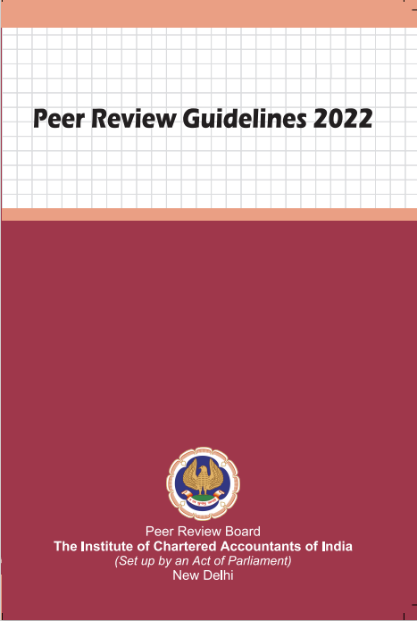
Peer Review
CA Niranjan Joshi

Slide 104
Peer Review Guidelines 2022
Effective from 01.10.2022
Peer Review - means an examination and review of the systems and procedures to determine whether the same have been put in place by the Practice Unit for ensuring the quality of assurance services as envisaged by the Technical, Professional and Ethical Standards as applicable including Audit Quality Maturity Model wherever applicable or any other regulatory requirements as may be prescribed by the Council or any Committee and whether the same were consistently applied during the period under review;
CA Niranjan Joshi

Slide 105
Peer Review Guidelines 2022
The main objective of Peer Review is to ensure that in carrying out the assurance service assignments, the members of the Institute –
comply with Technical, Professional and Ethical Standards as applicable including other regulatory requirements thereto and
have in place proper systems including documentation thereof, to amply demonstrate the quality of the assurance services.
The Peer Review process shall apply to all the assurance engagements signed by a Practice Unit during the period under review.
CA Niranjan Joshi

Slide 106
Questions
CA Niranjan Joshi

Slide 107
CA Niranjan Joshi,
B.Com., FCA, DISA (ICAI)
Email: nvjca1@gmail.com
Cell: 8369577210

